Slide 1

Caio and Santiago
Final Presentation: Raspberry Pi Server

Slide 2
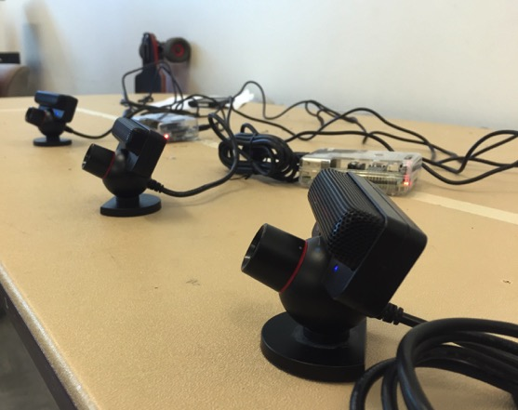
PlayStation Eye camera
Client:
IP = 192.168.0.10
Camera: (Detects blue)
lower = 50 0 0
upper = 255 255 255
Calibration:
Object Size = 5
Measured Distance = 30
Focal = 111

Slide 3
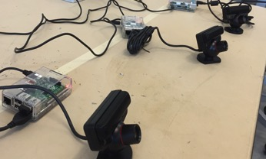
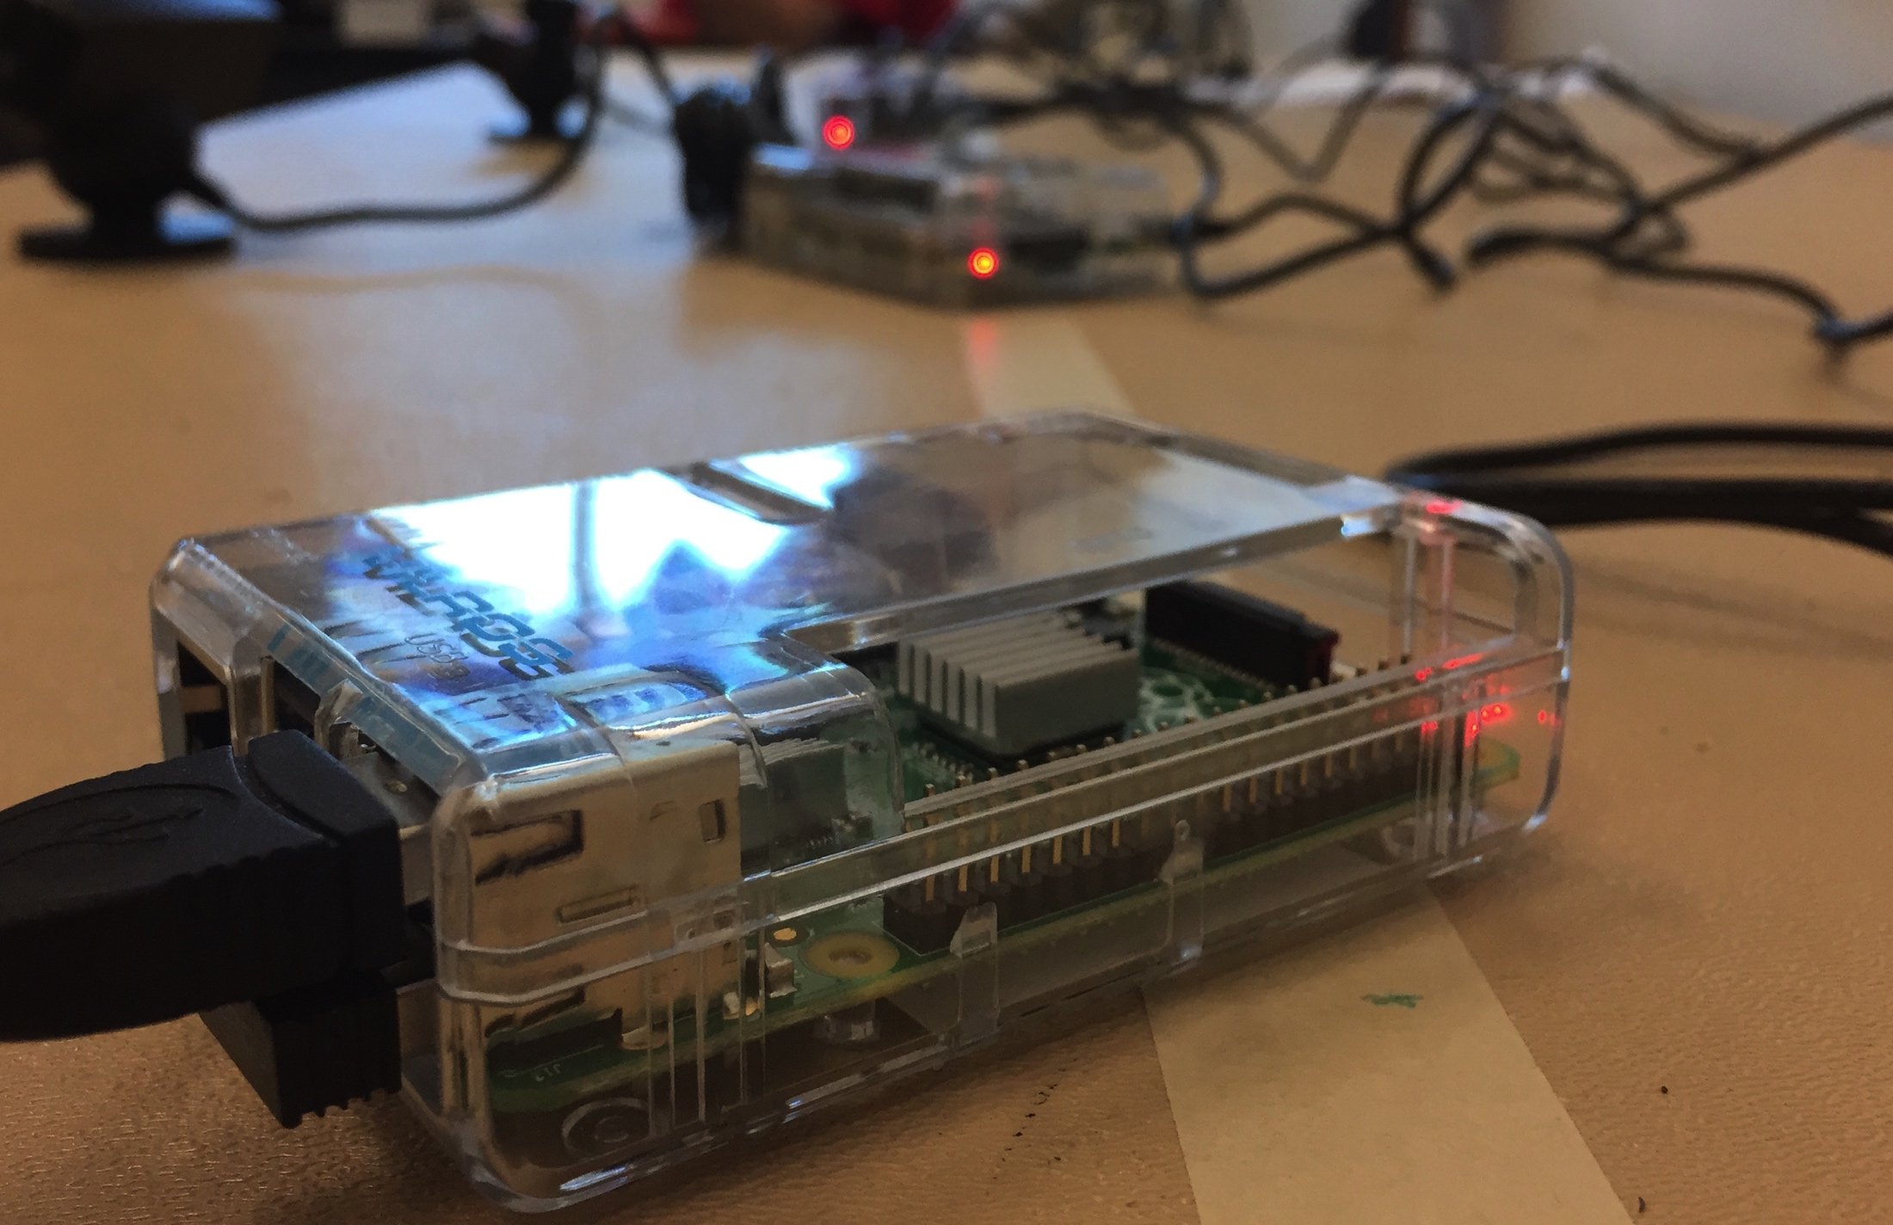
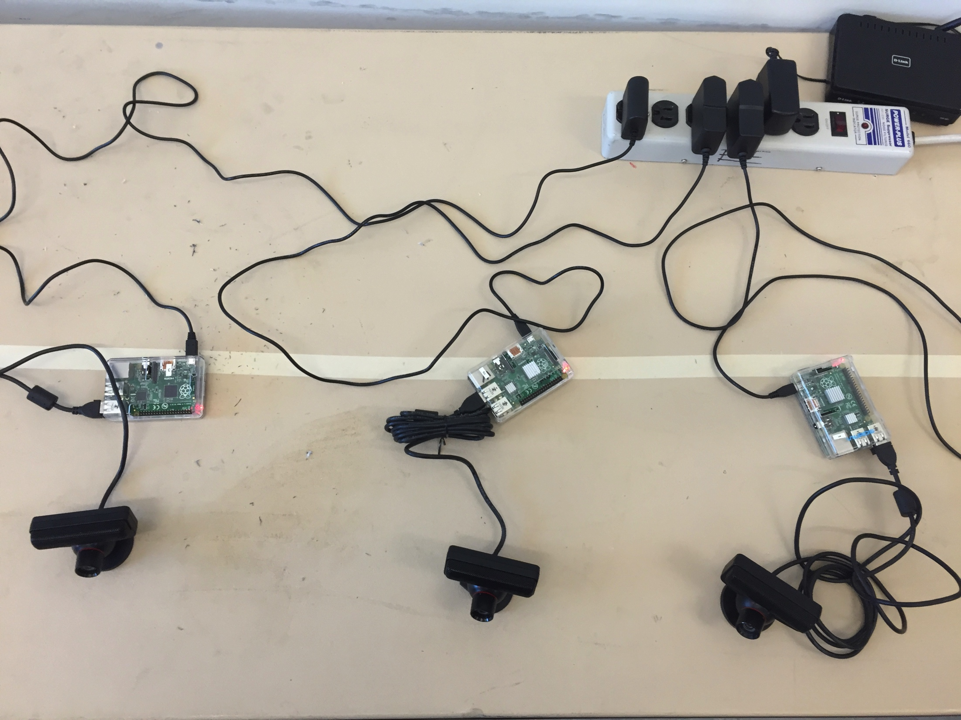
Four Raspberry Pies
*only 3 Pies are shown in picture
since fourth was not necessary for
this set up.

Slide 4
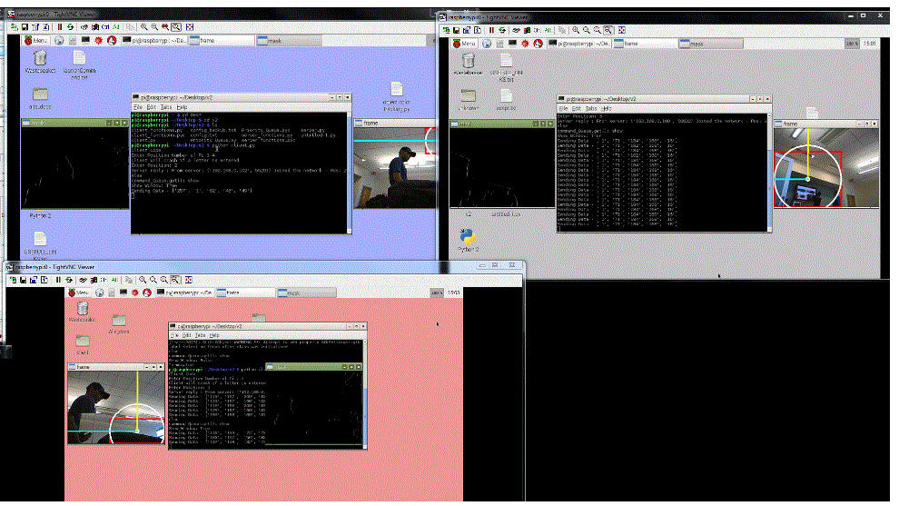
Three pies connected to OpenCV

Slide 5
Setting up the server:
server Commands (case sensitive)
data 1 - returns raw data string (no error check)
state 1 - returns the state of the cleint's camera.
loop - requests data from all clients (no error check)
kill - Asks for index to kill
kill_All - kills all
exit - kills server and Client
show 1 - opens the preview - or - Closes the preview - Will launch with no preview (experimental)
Syntax for commands is as follows: command (space) postion of Pi
add - adds a pi to the network
data_loop - loops all the piis, if one send wrong data it asks for it again.

Slide 6
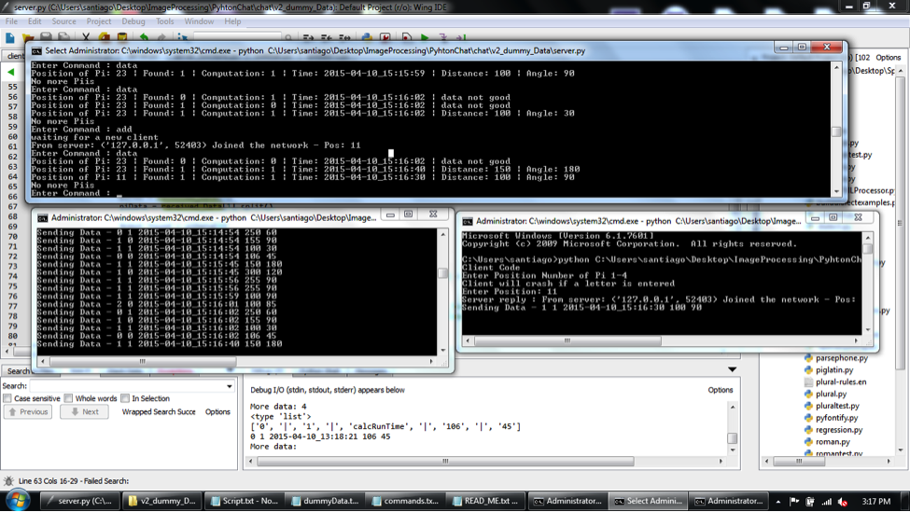
Setting up Pt. 1: Test Run
Dummy data
Client sending data
Server

Slide 7
Dummy data sample:
line | Robot_Found | Computation_Done | Time_Stamp | Distance_Robot | Angle_to_robot
1 | 1 | 1 | calcRunTime | 100 | 90
2 | 1 | 1 | calcRunTime | 100 | 85
3 | 0 | 1 | calcRunTime | 250 | 60
4 | 1 | 0 | calcRunTime | 155 | 90
5 | 1 | 1 | calcRunTime | 100 | 30
6 | 0 | 1 | calcRunTime | 106 | 45
7 | 1 | 1 | calcRunTime | 150 | 180
8 | 1 | 0 | calcRunTime | 300 | 120
9 | 1 | 1 | calcRunTime | 255 | 90
Null
*All Distances calculates in inches.

Slide 8
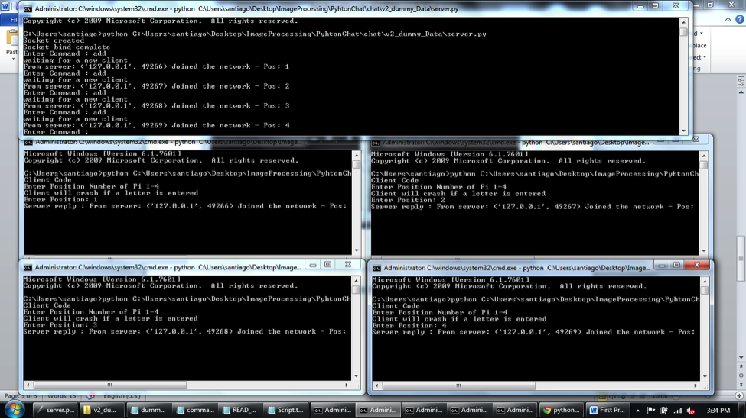
Setting up Pt. 2: Four clients connected to server
server
Client 1
Client 2
Client 3
Client 4

Slide 9
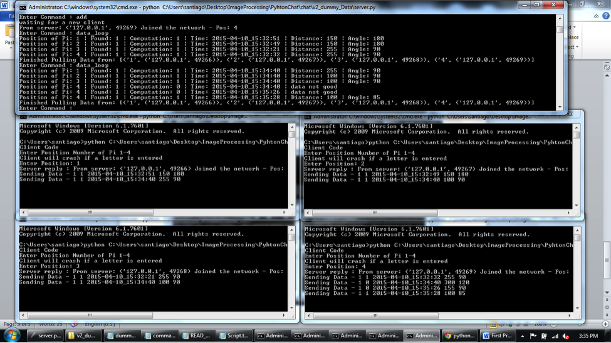
Four pies connected to server doing error checking:
Bad data
Throws error
*Client side sends either 1 for ok or if bad data, if server receives a 0 it runs
Tells the client to resend data until a 1 is arrived.

Slide 10
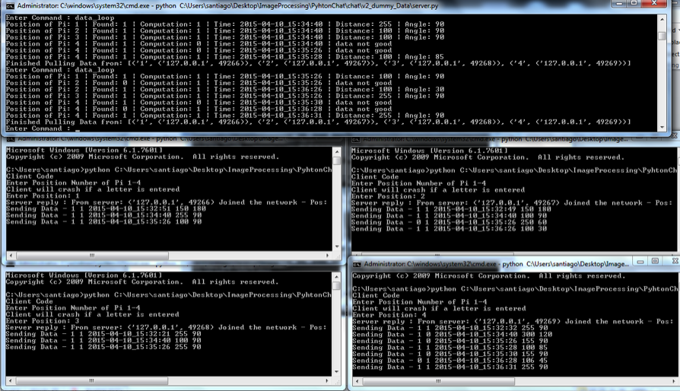
Four pies connected with multiple clients throwing errors:

Slide 11

Thank You Note
It was a pleasure working with you all during this project/semester and we wish you much success. Hopefully one day all of our hard work putting together this idea will help High School student learn math in a way we never had a chance to.

